Slide 1
DevOps Planning
Tools: Jira, Trello, Azure DevOps — 5 presenters

Slide 2

Introduction
Planning in DevOps is the initial phase that sets scope, priorities, and timelines for delivery.
It aligns stakeholders around goals, defines requirements, and assigns responsibilities to enable continuous delivery and efficient collaboration.

Slide 3
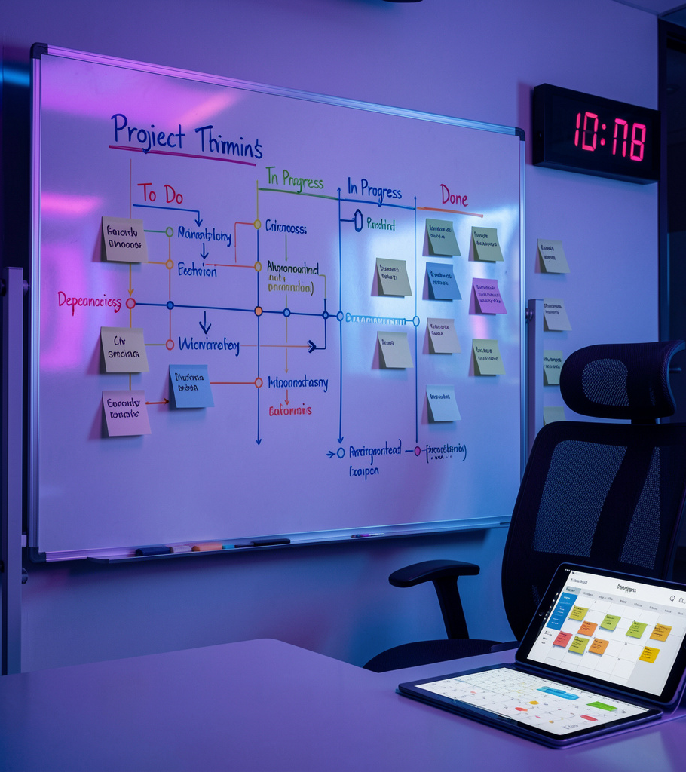
01
Planning Phase

Slide 4
Definition
The Planning Phase establishes project objectives, user stories, and sprint backlogs.
It defines scope, acceptance criteria, and resource allocation to create a clear roadmap for implementation and testing.

Slide 5
Importance
Effective planning reduces risks, shortens delivery cycles, and improves stakeholder alignment.
Clear plans enable predictable releases and better team coordination across Jira, Trello, or Azure DevOps.

Slide 6

Deliverables
Define requirements, user stories, and acceptance criteria to form the product backlog.
Assign ownership, estimate effort, and create sprint plans to ensure a ready-to-start backlog and aligned stakeholder commitments.

Slide 7
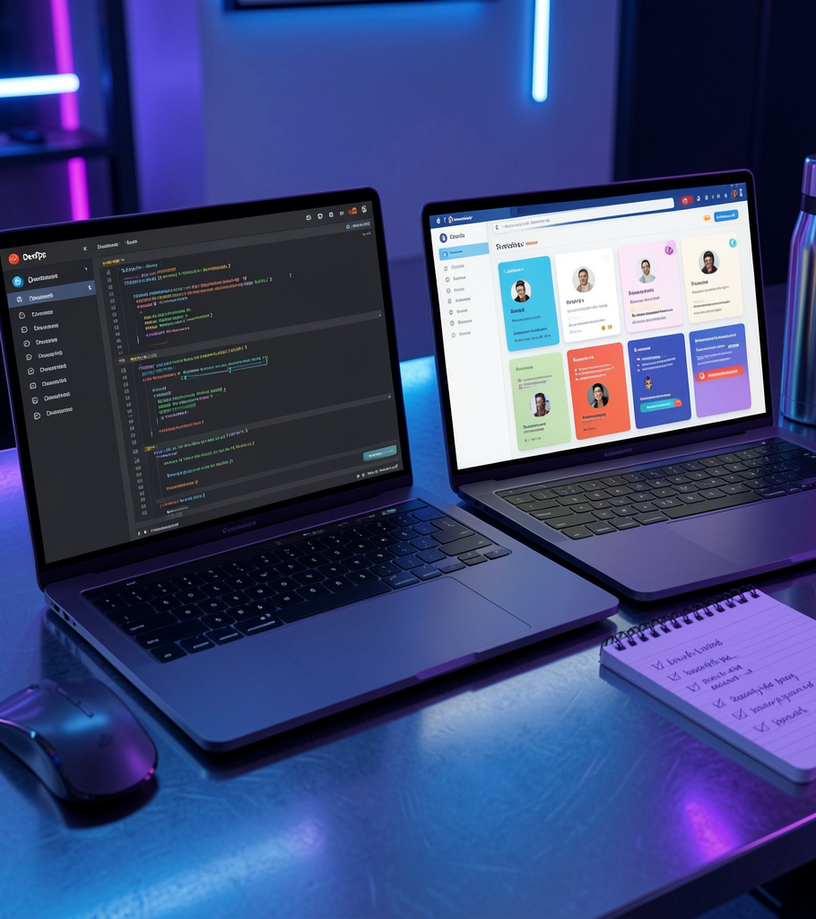
02
Tool Comparisons

Slide 8
Jira Overview
Jira is an issue-tracking and Agile planning tool with robust backlog and sprint management.
Supports customizable workflows, reporting, and automation to enable scalable Agile practices across teams.

Slide 9
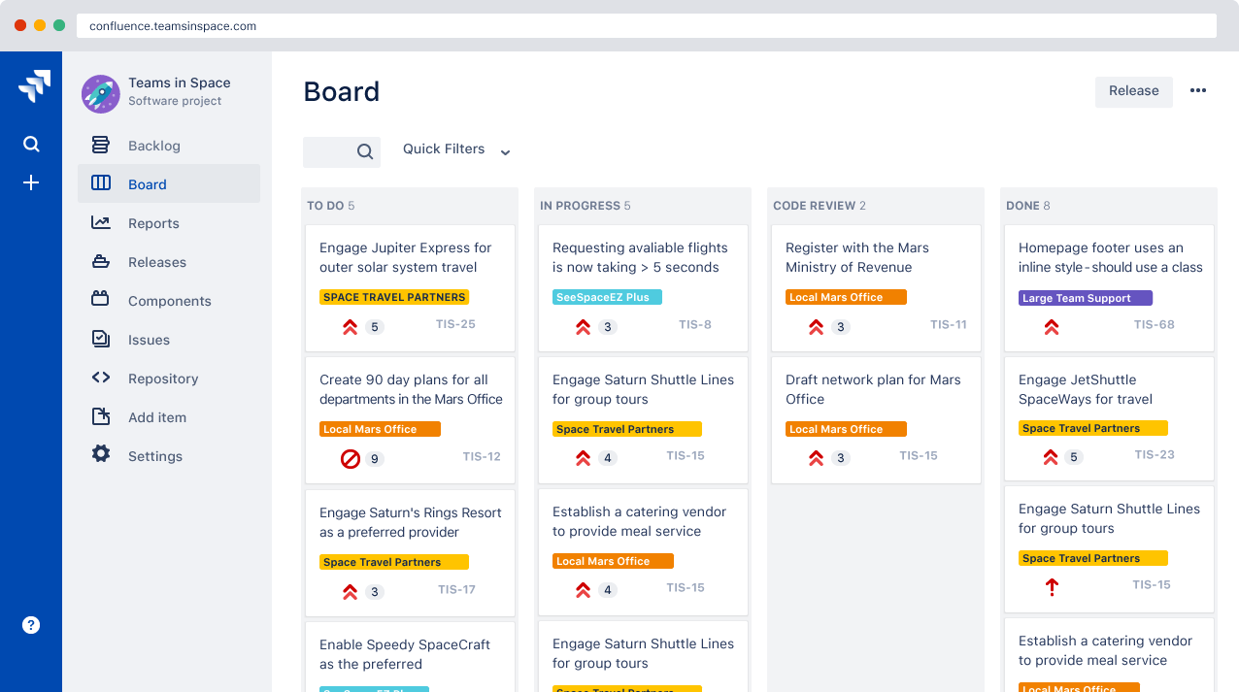

Slide 10
Core Concepts
Jira structures work through four foundational elements: [1]
Issues: Individual units of work (e.g., a bug, task, or user story).
Projects: Collections of issues grouped by a team or a common goal.
Boards: Visual workspaces (like Scrum or Kanban) that show the team's flow.
Workflows: The step-by-step path an issue takes from "To Do" to "Done". [1, 2]

Slide 11
🛠️ Key Features
Agile Planning: Native support for Scrum sprints and Kanban boards to optimize team capacity.
No-Code Automation: Saves time by handling repetitive tasks and updating dependencies automatically.
Real-Time Reporting: Out-of-the-box dashboards that track progress, cycle times, and goals.
Extensive Marketplace: Integrates natively with over 3,000 external apps, including Slack, Figma, and Bitbucket. [1, 2, 3, 4, 5, 6, 7]

Slide 12
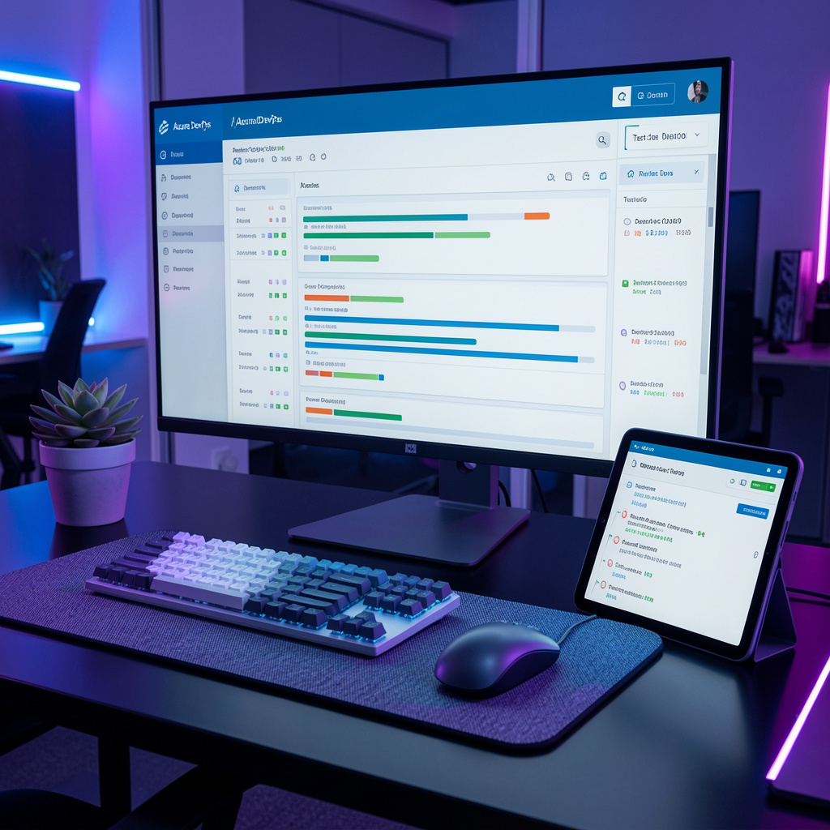
Azure DevOps Overview
Azure DevOps is a full DevOps platform integrating planning, repos, pipelines, and testing.
Delivers end-to-end CI/CD and strong Microsoft ecosystem integration for enterprise-scale delivery and automated releases.

Slide 13
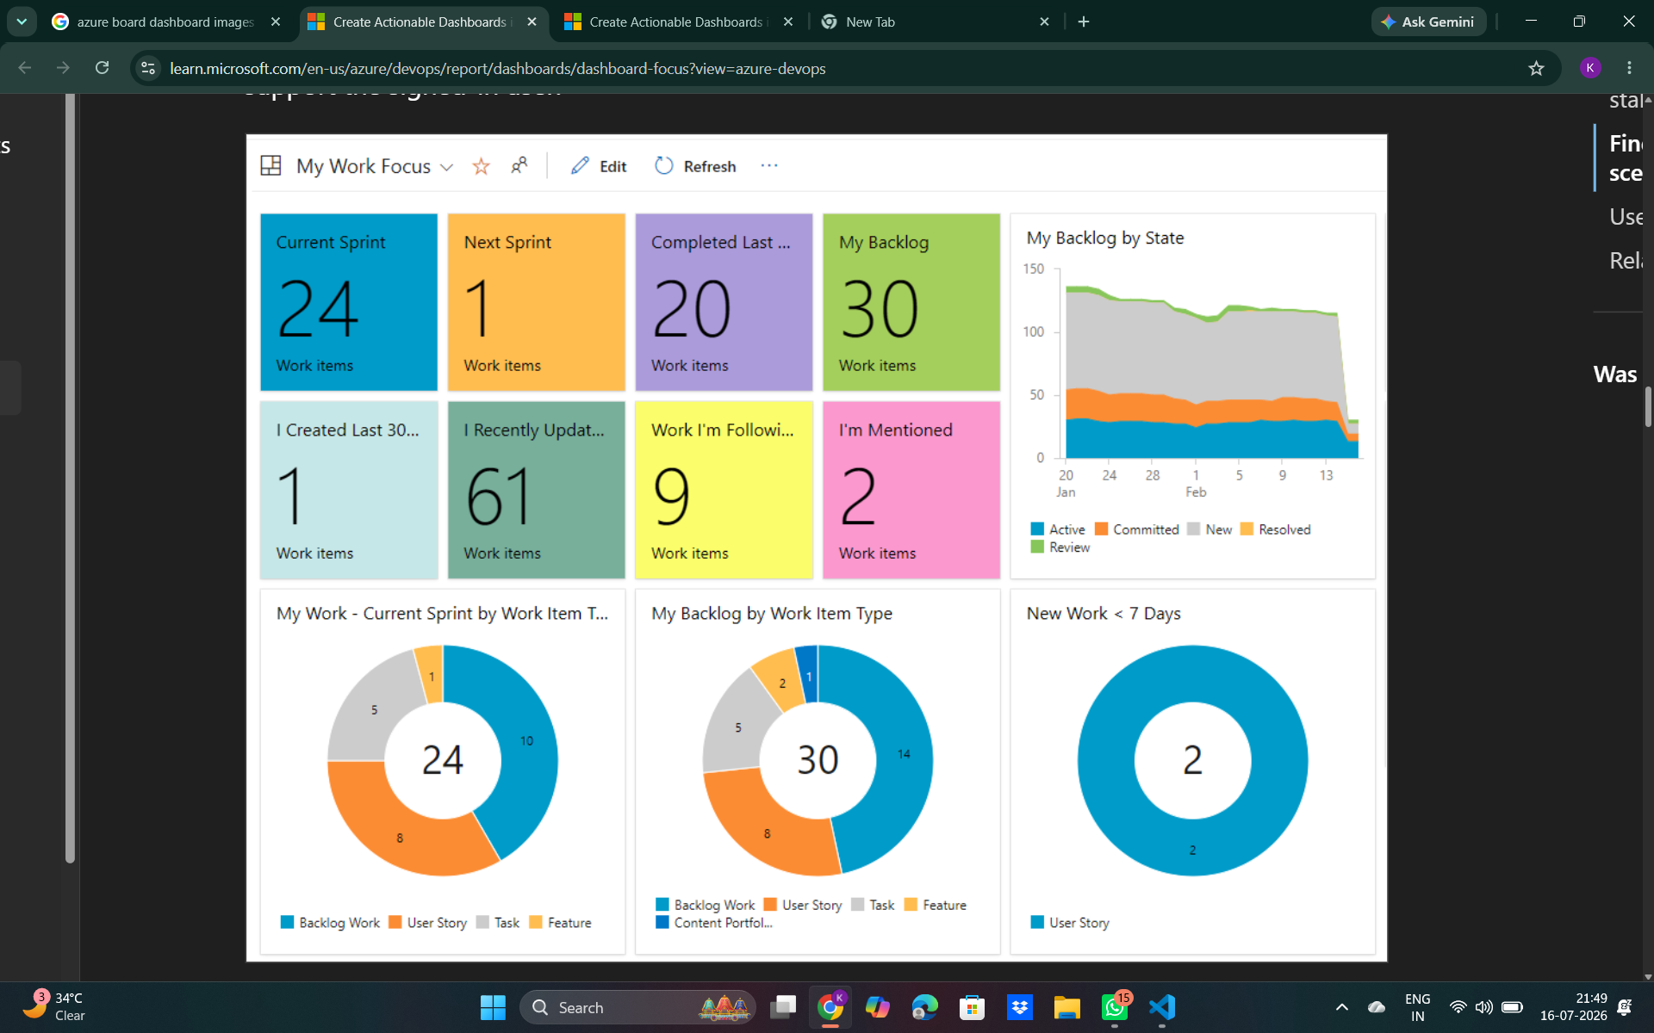
personal dashboard

Slide 14
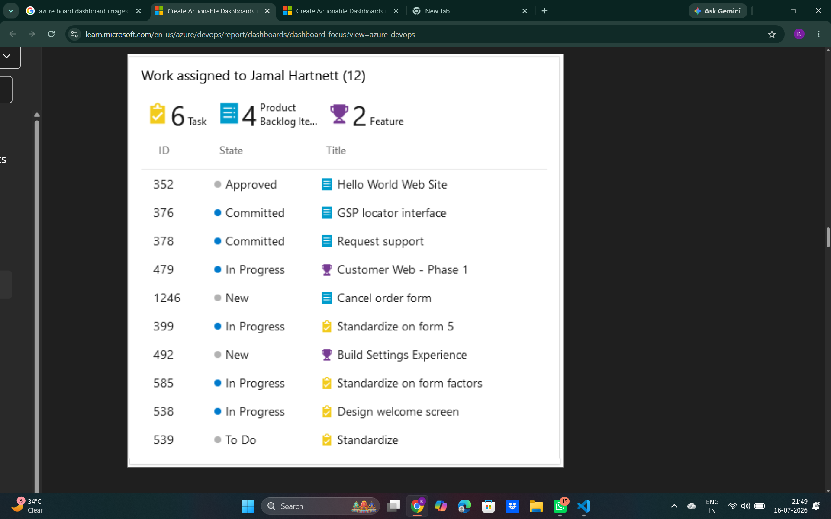
By using a personal-focus dashboard, each team member can see their own work assignments, other work they're following, or work where they're mentioned. Create a personal dashboard by using the Assigned to me widget and other query tiles or charts that reference an Assigned To = @Me query clause.

Slide 15
Team dashboard
A team dashboard helps members meet goals, monitor status, track progress, identify bottlenecks, and ensure backlog items are well defined. Create a team dashboard by including one or more of the following team-scoped widgets:
Cumulative flow diagram (CFD) chart: Monitor the flow of work items and track work item count by sprint stages.
Velocity metrics: Track the team's capacity to deliver work sprint after sprint.
Cycle time: Add time measurements to track how long it takes your team to complete work items.
Lead time: Add time measurements to track the time to create through the time to complete for work items.

Slide 16
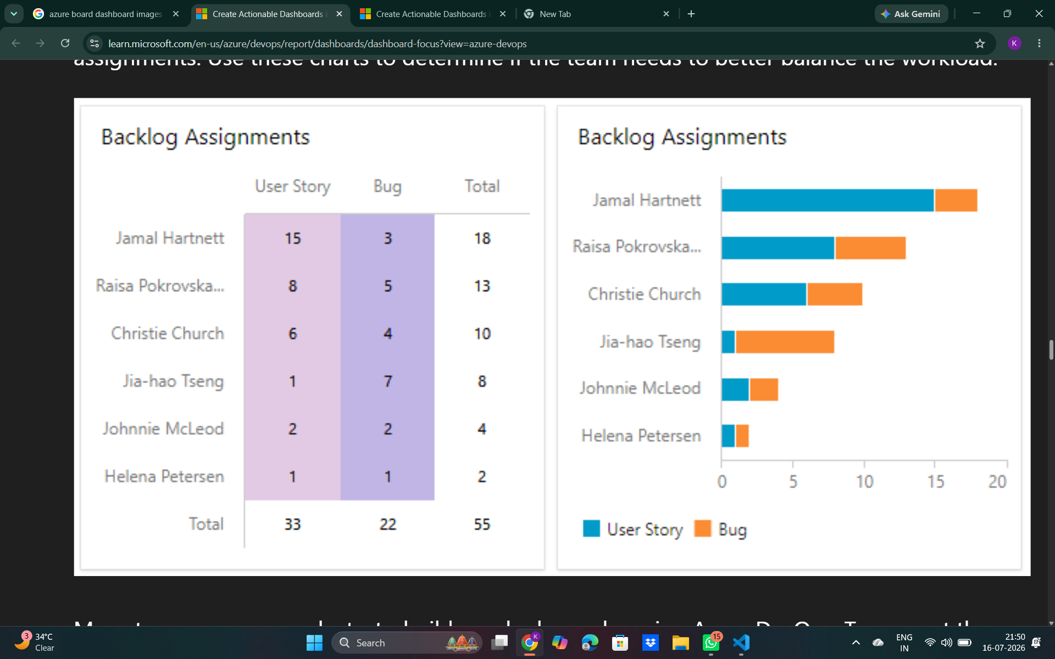

Slide 17
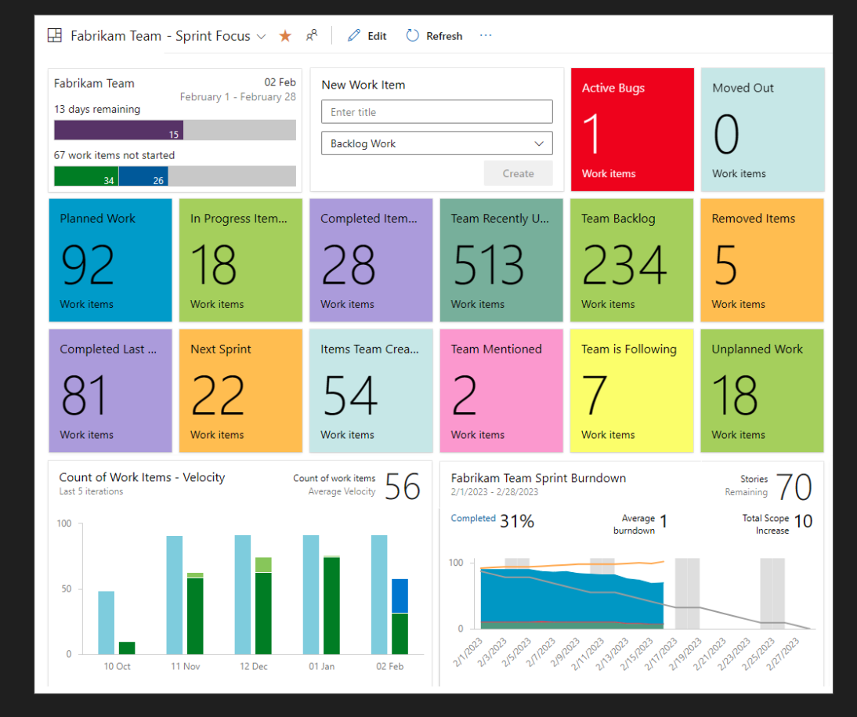
Sprint dashboard
Azure DevOps offers several sprint and team-specific widgets to track sprint progress, including Sprint overview, Sprint capacity, and Sprint burndown. You can show the Sprint capacity when your team tracks work by using tasks and sets the Sprint capacity.
The following image shows a sample sprint-focus dashboard:

Slide 18
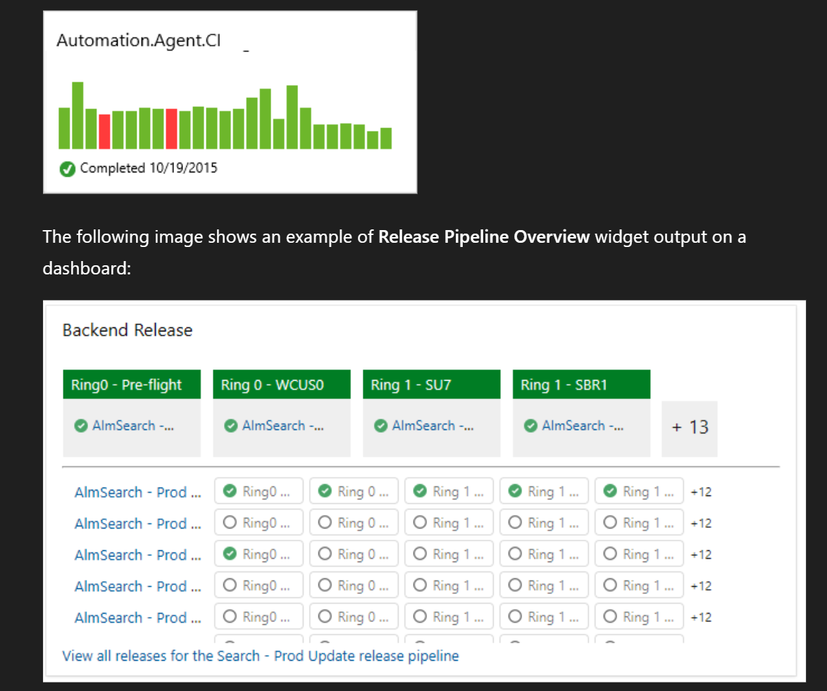
Release dashboard
Major software releases often involve contributions from multiple teams. Release burndown and burnup charts help product managers track progress across teams. You can highly configure these charts. You can choose teams, backlog work items or work item types, field criteria, countdown metrics, and time intervals. For more information, see Configure a burndown or

Slide 19
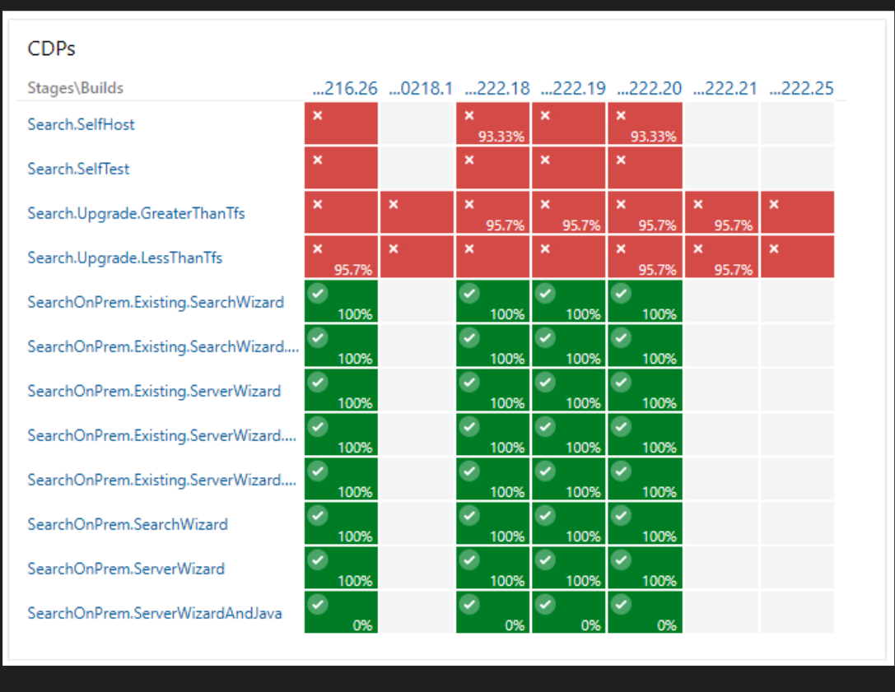

Slide 20
Trello Overview
Trello provides a visual Kanban interface with boards, lists, and cards for simple task tracking.
Ideal for lightweight workflows and rapid team adoption, enabling quick prioritization and collaboration.

Slide 21
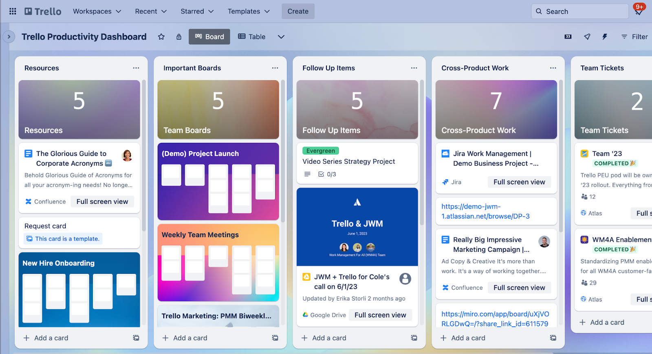

Slide 22
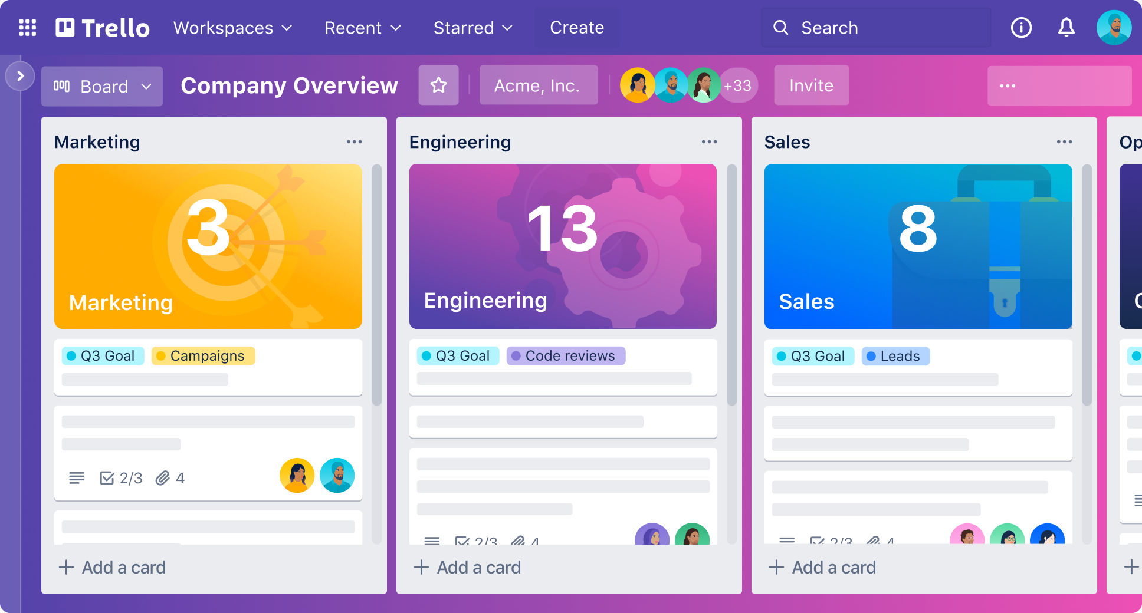

Slide 23
Native Trello Dashboard Features
Visual Data Tiles: Summarize your board's metrics using interactive bar charts, pie charts, and line graphs. [1]
Customizable Groupings: Configure tiles to display:
Cards per List: Shows where work is sitting (pipeline health).
Cards per Member: Balances team workload and spots overworked team members.
Cards per Label: Helps visualize priority mix and resource allocation.
Due Dates: Highlights upcoming or overdue tasks to prevent roadblocks. [1, 2, 3]
Dynamic Filters: Drill down on data by specific labels, team members, or due dates to run targeted check-ins. [1, 2]
Real-Time Updates: Tiles automatically update as cards are created, modified, or completed across your board. [1, 2]

Slide 24
Conclusions
Effective planning yields clearer scope, reduced risk, and predictable delivery timelines.
Select Jira for advanced Agile control, Trello for visual simplicity, and Azure DevOps for a complete enterprise DevOps ecosystem.

Slide 25
Thanks!
Do you have any questions?

